Slide 1

NRI INSTITUTE OF TECHNOLOGY COMMUNITY SERVICE PROJECT
UNDER THE GUIDENCE OF Mr.T. RATNA KUMAR

Slide 2
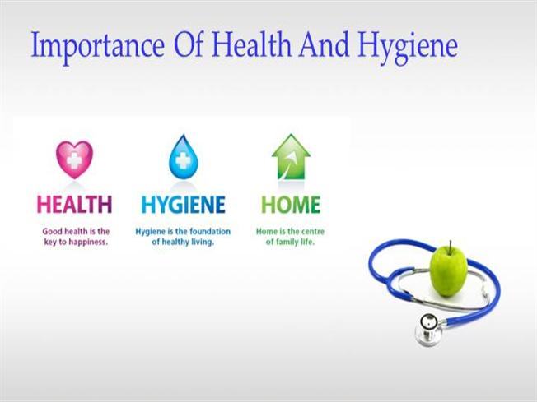
HEALTH AND HYGIENE
submitted by:
K.S.L. Pavani- 20KP1A4415 T. Vishnu Vardhan- 20KP1A4456 Ch. Sravani- 20KP1A4406 N. Phanidhar- 20KP1A4431

Slide 3
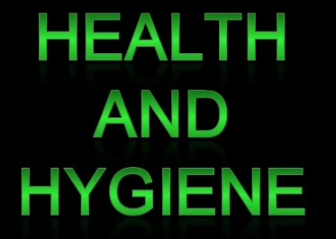
INTRODUCTION
Health refers to a person's physical, emotional and psychological well-being.
Hygiene refers to good practices that prevent disease and lead to good health, especially cleanliness, proper disposal of wastewater and drinking water supply.
It refers to all the activities that are done to improve and preserve, maintain good health

Slide 4

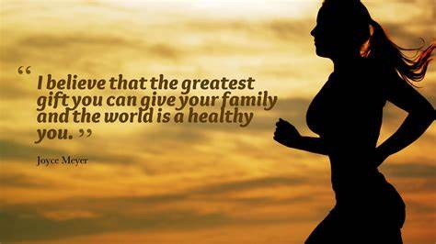

Health
Health is a quality of life that enables you to live a longer life. The World Health Organization (WHO) defines health as "a condition of complete physical, mental, spiritual, and communal well-being, rather than only the absence of illness.“
A person is not regarded as healthy if he is free of sickness or in good bodily shape but is stressed, tense, angry, greedy, or in any other way.
Health is a positive state of being in which all components of the body and mind are in proper balance and harmony with one another. As a result, all of the body's organs are in good working order.
Class | Group 1 | Group 2
Class 1 | 2 | 95
Class 2 | 76 | 88
Class 3 | 84 | 90

Slide 5
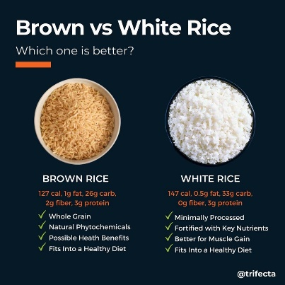
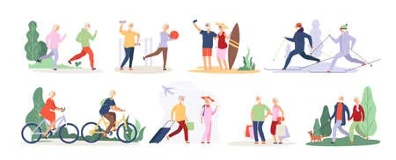
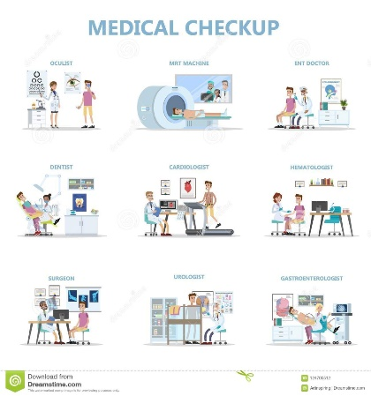
Food- Brown rice is more nutrient-dense than white rice. Because of this, brown rice may help reduce blood sugar levels and aid in weight management efforts. However, white rice is good for those with certain digestive issues who cannot digest fiber-rich foods well.
Fitness-Walking, lifting weights, doing chores – it’s all good. Regardless of what you do, regular exercise and physical activity is the path to health and well-being. Exercise burns fat, builds muscle, lowers cholesterol, eases stress and anxiety, lets us sleep restfully
Medical check up- People have to take a monthly checkup or 6 months to know our body conditions like dental,eye, CBC, LPT,CHT,etc and have take precautions if there are any mild changes in our reports

Slide 6
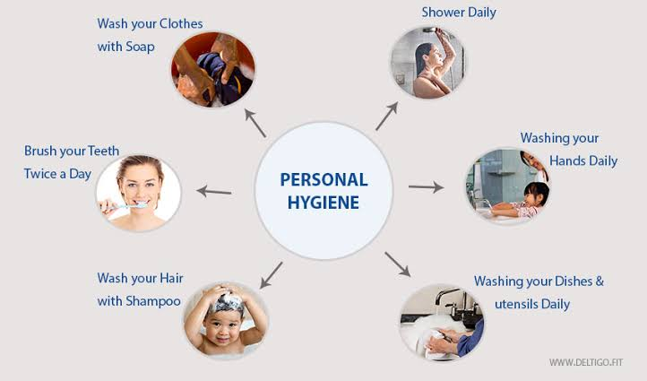
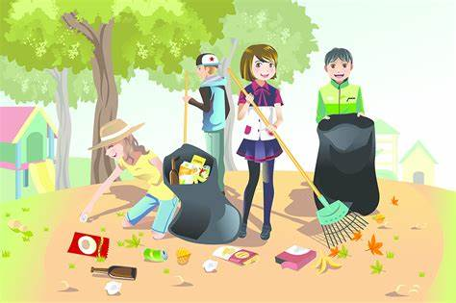
HYGIENE
According to the World Health Organization (WHO), “Hygiene refers to conditions and practices that help to maintain health and prevent the spread of diseases.
Maintenance of hygiene can be at the community level (social hygiene) or personal level (personal hygiene).
.
Improper, unkempt and untidy surroundings and inappropriate ways of waste disposal in public places results in the unhealthy surrounding
Such practices can cause an alarming growth of rodents, pathogens and other microbes, which can make us unwell.

Slide 7
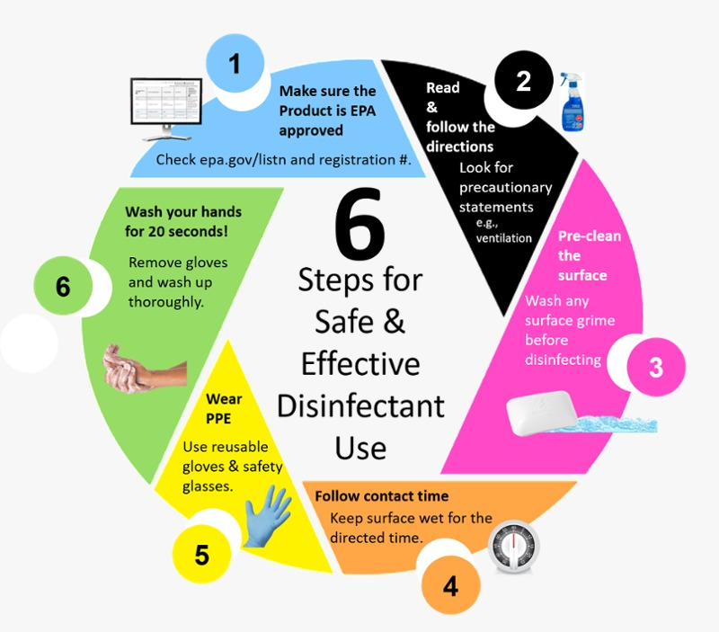
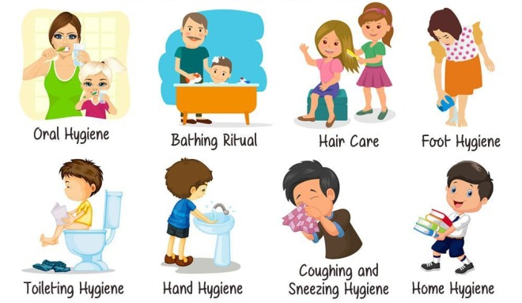
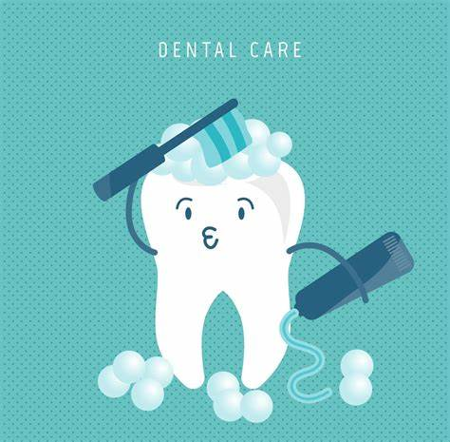
Cleanliness
Cleanliness is one of the most important elements of good health. Thus, it is an important hygiene habit to keep yourself and your surroundings neat and clean. Whenever there is dirt, there are germs that thrive in it. Also, the dirt is light in air and thus it moves around in the air. So, a dirty man is often the one that is attacked easily with various diseases.
NAILS
Fingernails may harbour dirt and germs, contributing to the spread of bacteria. It is easier for dirt and germs to collect under longer nails, so keeping them short can help reduce the risk of spreading infections.
DENTAL
Dental hygiene involves more than just having white teeth. A good dental hygiene routine can help prevent issues such as gum disease and cavities. It can also prevent bad breath.

Slide 8
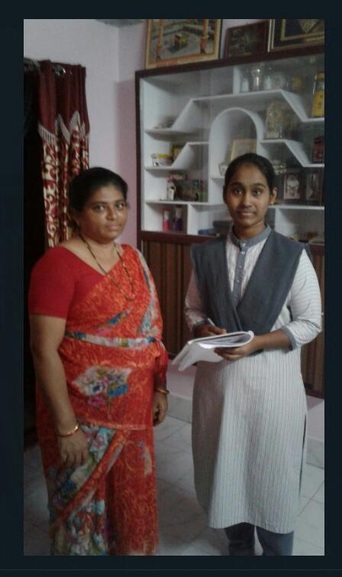

PROCUDURE

Slide 9
QUESTIONS WE ASKED
Are you go for any regular medical check ups [ eye ,dental … etc ]
If you have children less than 5 years[ dose he/she vaccinated with polio drops]?
Are there any diabetic patients in your family?
Which type of medical treatment your family prefers ?
[ ayurvedic/English medicine]
Does your family follow yoga / physical fitness regularly?
Does your water containers are opened or closed ?

Slide 10

Which type of food your family prefers?
[brown rice/white rice]
Does your family follow yoga / physical fitness regularly?
[ walking/ exercise/]
Does your water containers are opened or closed ?
Does your family members use masks and sanitizers while going out ?
Does the GMC workers will come regularly to clean the garbage ?

Slide 11
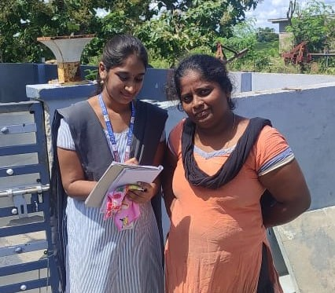
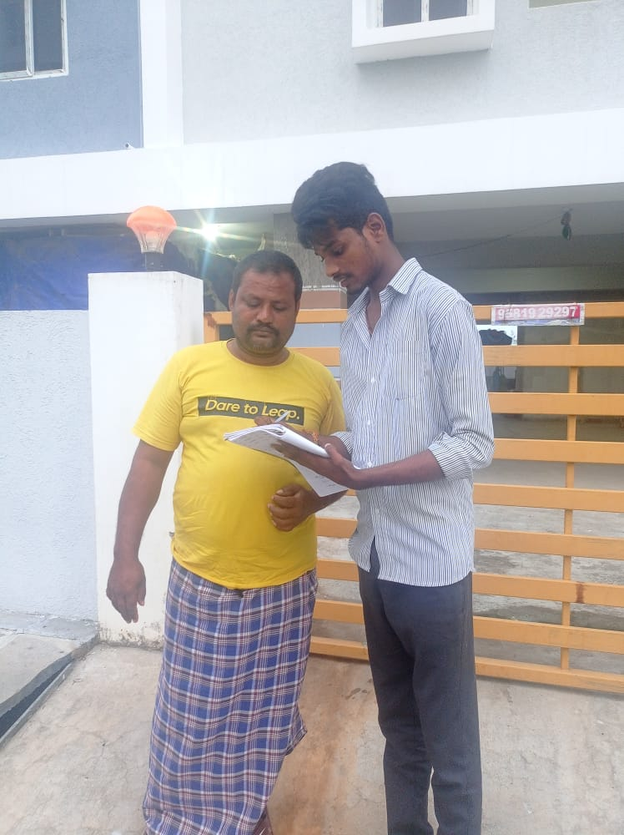
There response are
Most of the People are taking the white rice
Most of the People are going to walk regularly
Most of the People are not going for any regular medical checkups.
Only a few are taking the dairy products
Some are taking the malts which gives energy
Only a few are following hygienic measures.
Most of the people are growing plants in their houses

Slide 12
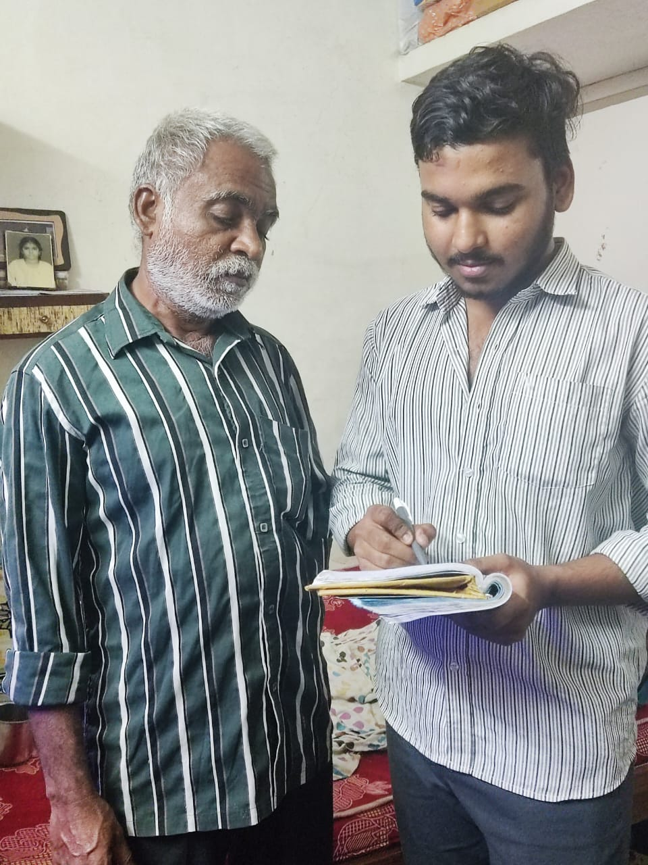
Some of the health and hygienic tips which we have suggested to people
Do yoga / walking regularly
It’s good to take a glass of hot water in the early morning
Maintain your surroundings in neat and clean
People have to take the food which improves their immunity levels .
People can use moisturisers and sun screen lotions for a healthy skin

Slide 13
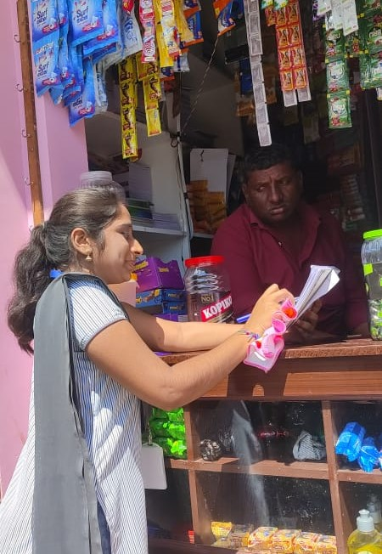
s
Covering your mouth and nose with a tissue when sneezing or coughing
Store foods appropriately both before and after cooking
Make a good sleep environment
People should limit alcohol and caffeine if they are habituated.
Clean surfaces regularly
Maintain your personal hygiene

Slide 14
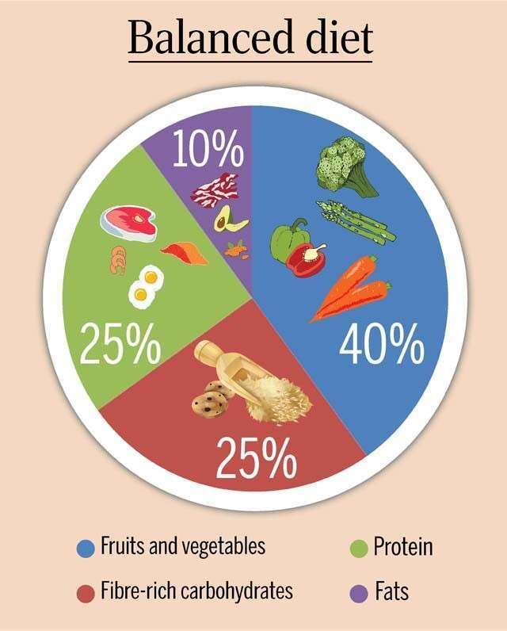
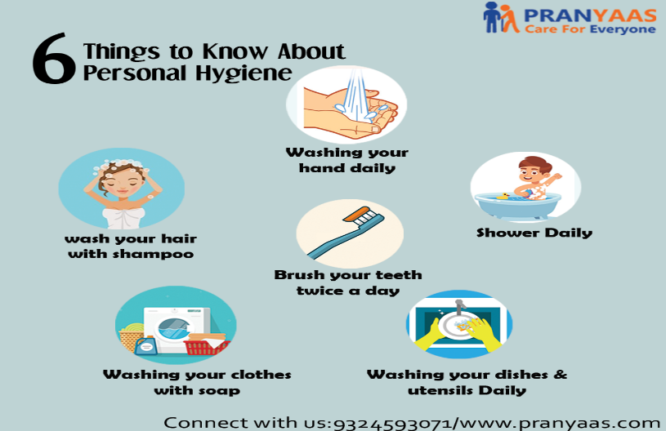
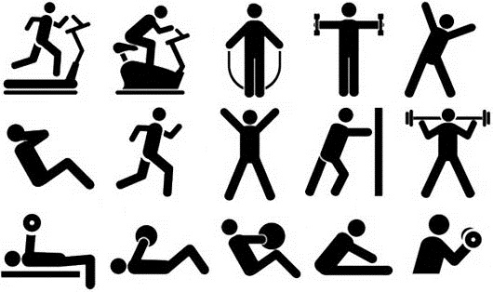
Factors we should follow for healthy life
Balanced Diet
Personal Hygiene
Regular Exercise

Slide 15
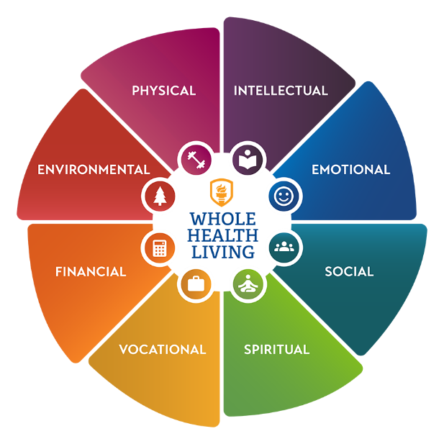
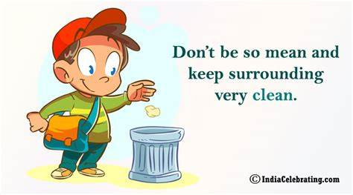
CONCLUSION
As our team started this, Community service. We thought it was easy to do and there will be
no problems we are going to phase.
But we were wrong it was not easy to do community service, but we didn't quit. By doing this
community service we have learned how to be patience and how to talk/interact with the
people
As the day 1 we started, the way of challenges is different from the other day. Each day has
different challenges and out comes
The people we contacted while doing this service have been patience and gave the answers
what we have questioned them with a polite manner, and they suggested us few questions
too. The way of interaction with us very good from people, our team have learned so much
from community/society
Even not only in service, but daily me and my team will try our level best to help people and
share knowledge to them
At last We got to know about how people health conditions exists and how they are aware
about all the these topics of health and hygienic.

Slide 16
THANK YOU

